Slide 1

NEW COACH,
NEW ENERGY?
YIMING ZANG ,JIAHUI FAN
JUNE.16。2025

Slide 2

Hook
This presentation delves into the performance changes observed in Bundesliga teams following coaching changes from 2017 to 2025. We will analyze offensive metrics, including expected goals (xG), goals scored, and overall efficiency, providing insights into the dynamics of the 'new coach effect'.

Slide 3

01
Does Changing the Coach Really Work?

Slide 4
Factors Influencing Short-Term Success
Several factors contribute to the short-term success after a coaching change. These include the psychological impact of a new leader, changes in tactics that better fit player strengths, and a temporary surge in motivation from the players. Additionally, the contrasting coaching style may disrupt opponent strategies, further contributing to a short-lived upswing in performance.

Slide 5
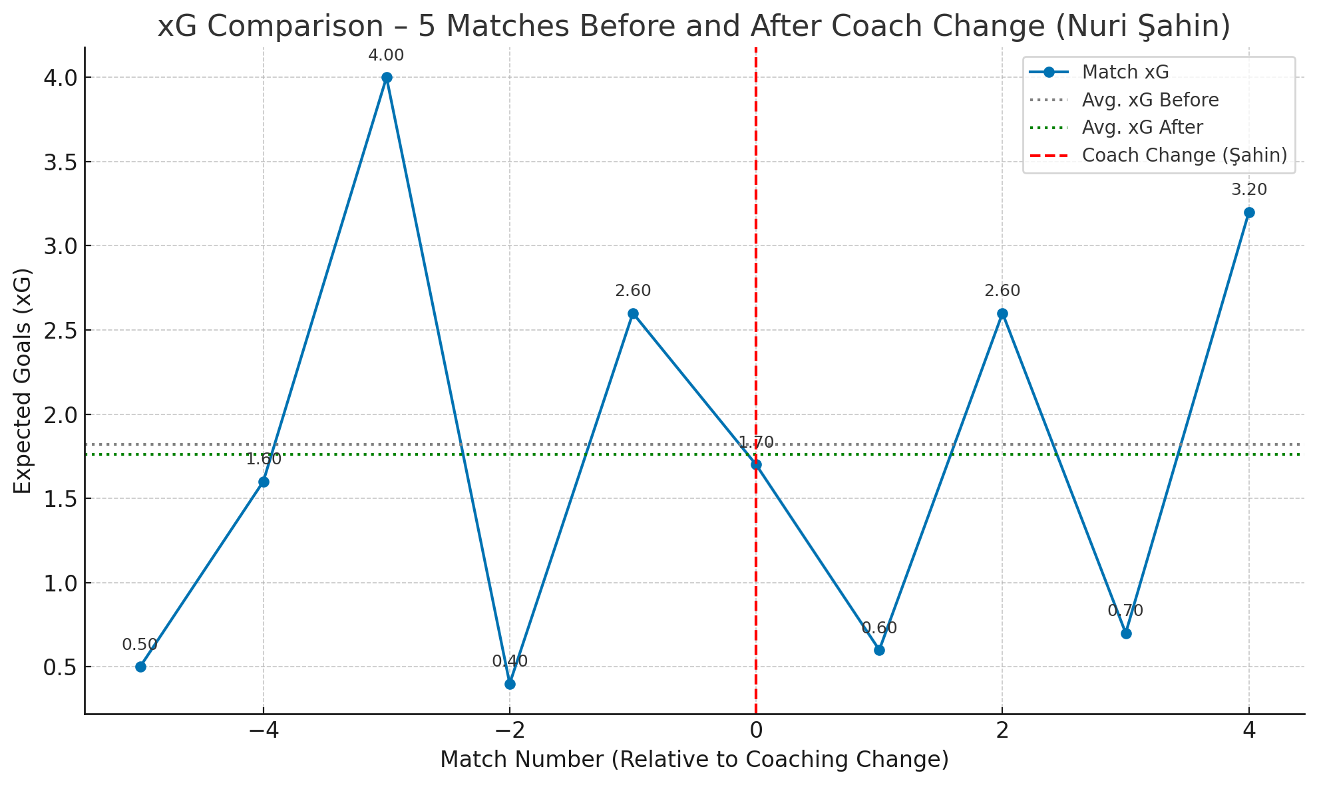

Did Performance Improve After the Coaching Change?
- from expected goal
The data shows that Dortmund’s offensive output, measured by xG, did not clearly improve in the five matches after Şahin’s appointment.
But does the “new coach effect” show up in other ways? Let’s look at results, efficiency, and longer-term trends.

Slide 6
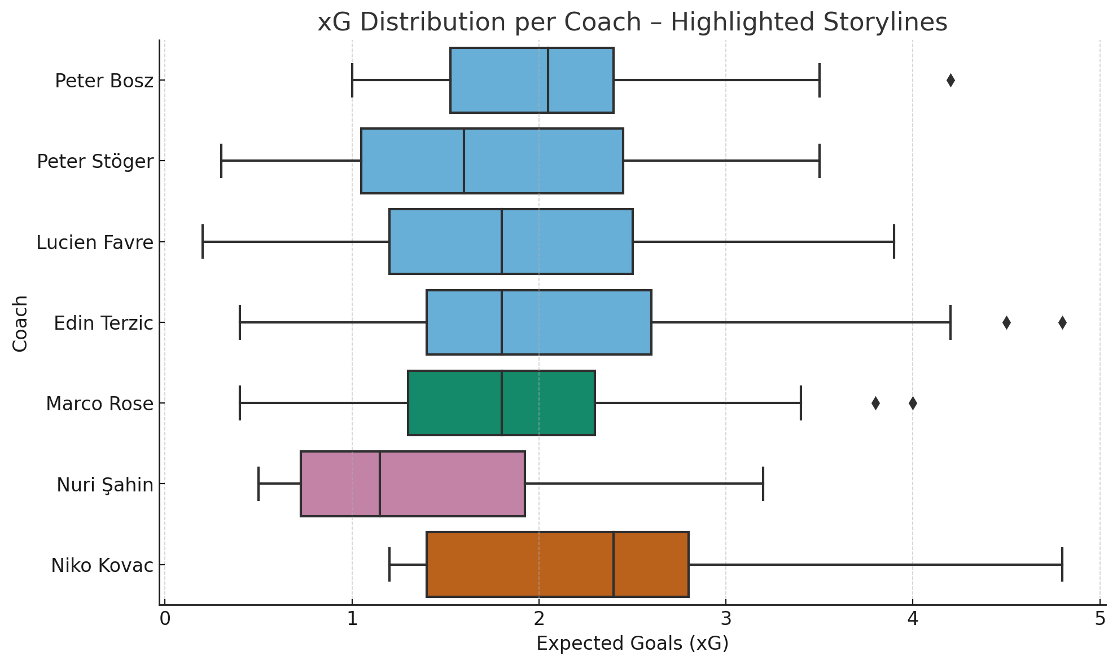
Different Coach, Different Impact — A Closer Look at Dortmund’s xG
🟧 Kovac delivered high attacking output, but with large fluctuations — aggressive, but unstable.
🟩 Rose’s tenure stands out for its balance: efficient and consistent, with tight xG distribution.
🟪 Şahin’s start has been quiet. His xG profile suggests a cautious or struggling attack.

Slide 7
Long-Term Adaptation and Regression
While initial performance boosts are common, many teams fail to sustain this momentum in the long run. Over time, performance metrics often regress towards historical averages unless the team effectively adapts to the new strategies implemented by the coach. Adjustments in player roles, tactical tweaks, and team cohesion play significant roles in determining long-term success.

Slide 8
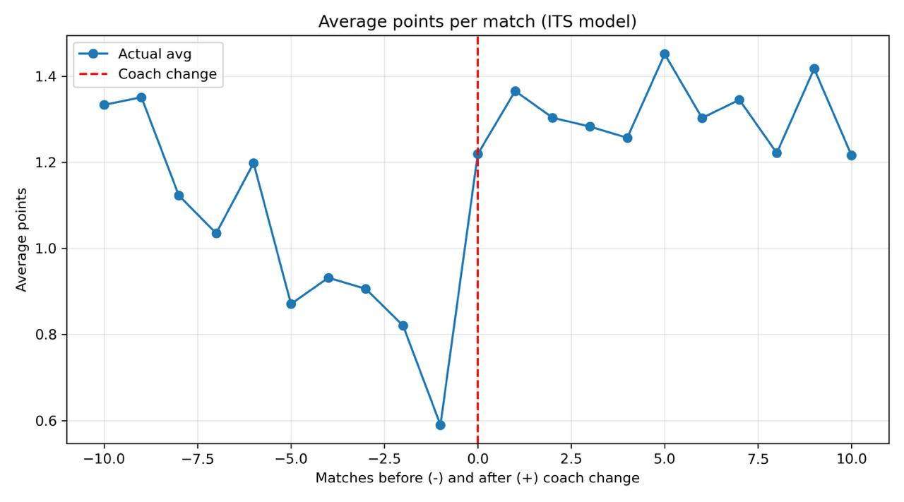
The Coaching Era in One Timeline

Slide 9
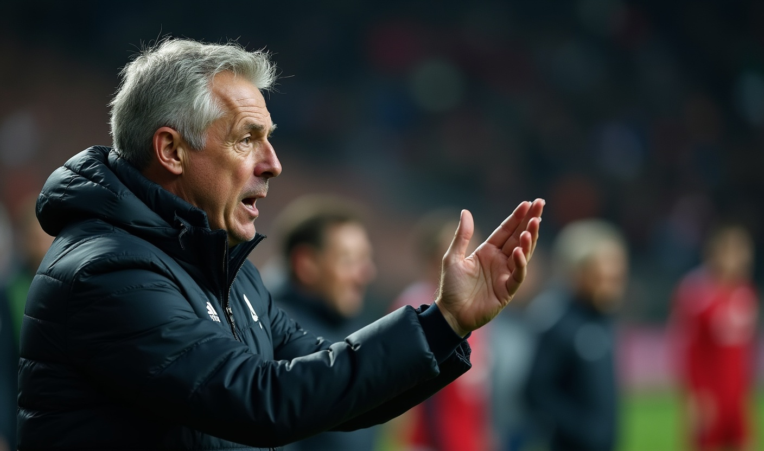
Impact of Coaching Changes on Teams
The initial impact of a new coach is frequently associated with a performance boost, particularly observable in key metrics such as xG and total goals scored. In many cases, teams show enhanced vitality and strategy adherence in the first two matches post-transition. However, this effect is typically short-lived, leading to a critical analysis of what drives lasting performance improvement.

Slide 10

02
What They Said — and What the Data Said
player/coach quotes

Slide 11
Does Changing the Coach Really Change the Game?
COACH ...’We want to be brave but mentality alone is not enough’... | PLAYER | FAN | DATA
1.43 | 38.9%
Avg.xG | Win Rate

Slide 12

Immediate Performance Boosts
Upon a coaching change, many teams display an immediate improvement in performance metrics. This phenomenon, often referred to as the 'new coach effect,' is characterized by heightened motivation and strategic clarity among players. Initial match results frequently reflect a spike in offensive capabilities, leading to increased goal-scoring and improved xG figures.

Slide 13

Conclusions
In conclusion, while coaching changes in the Bundesliga can lead to immediate improvements in team performance, these effects are often fleeting. A deeper understanding of the tactical adaptations required for sustained success is crucial for both teams and management. Future strategies should focus on long-term development rather than solely on short-term gains.

Slide 14
Thank you!

